Slide 1
Types of classification algorithms
Srikanth Gunturu
Guest Faculty
BITS, WILP

Slide 2
In this segment
Types of classification algorithms
Discriminant functions
Probabilistic Generative models
Probabilistic Discriminative models
Tree based models

Slide 3
Types of classification algorithms
Discriminant functions - Overview
Both inference and decision are performed together
Discriminant is a function that maps input vector directly to a class label.
Linear discriminant is a linear function, whose decision surface is a hyperplane
Examples:
Linear Discriminant
The Perceptron

Slide 4
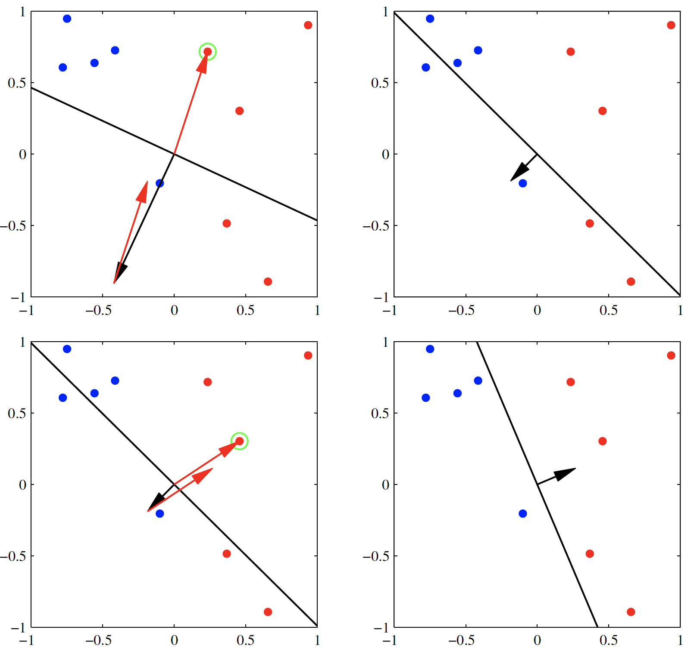
Types of classification algorithms
Discriminant functions – The Perceptron
Proposed by Frank Rosenblatt in 1962
Corresponds to a two class model
Associates zero error with correctly classified patterns
Tries to minimise the criterion quantity for misclassified pattern
Perceptron convergence (fig.)

Slide 5
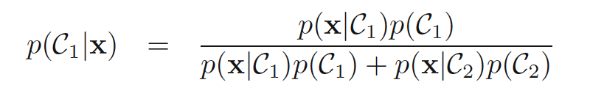
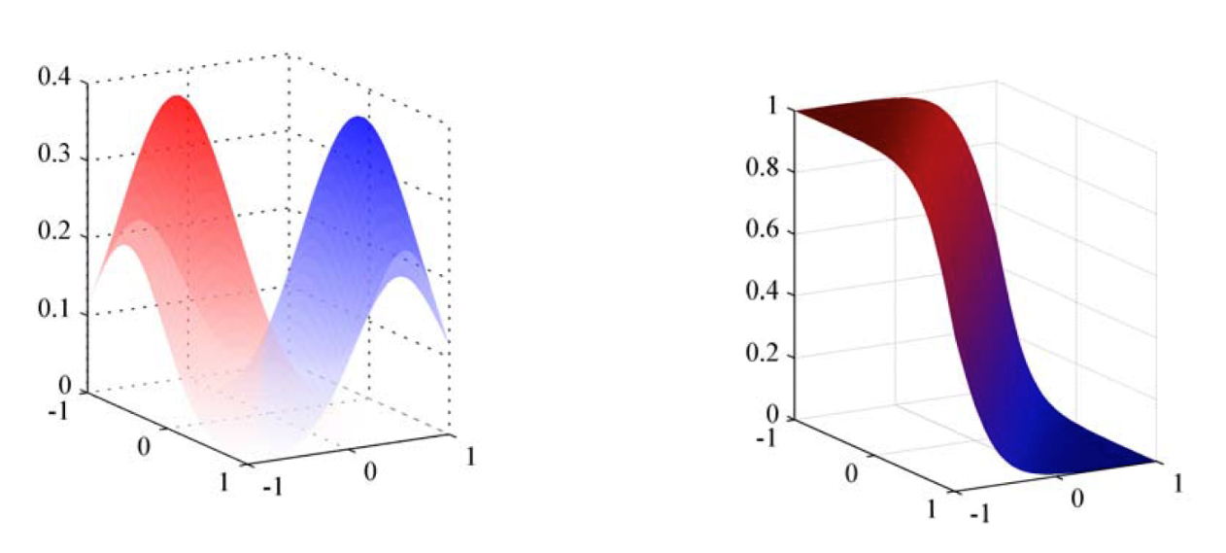
Types of classification algorithms
Probabilistic Generative Models - Overview
Uses probability theory to generate joint distribution of input and output variables, P(X,C) and then use that distribution to predict the class for a given new input set
Approach
Inference - Model joint distribution of input vector X and class C_{k}, using probability
Decision – Apply the model to given new set of input to determine probability of class C_{k}
Two-class – probability
Examples: Naïve Bayes, Gaussian Mixture Model etc.

Slide 6
Types of classification algorithms
Probabilistic Discriminative Models – Overview
Uses conditional probability of the class variable C_{k} given the input vector X, i.e. P(C_{k}|X)
Approach
Inference – Use conditional probability to model the probability of class variable given the input set, using training data
Decision – Use decision theory to assign each new input set to one of the classes
Examples – Logistic Regression

Slide 7
Types of classification algorithms
Probabilistic Generative Vs Probabilistic Discriminative Models
Generative Model | Discriminative Model
Derive joint probability distribution using training data | Derive conditional probability from training data
Requires considerably large training set to generate an decent model | Can work with moderate sized data as well, since the conditional probability is drawn from given input set directly
Models the actual distribution of each class | Models the decision boundary between classes
Use Bayesian theory to assign input to a class | Use maximum likelihood to assign an input to a class

Slide 8
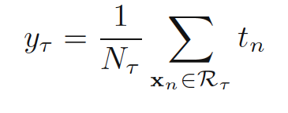
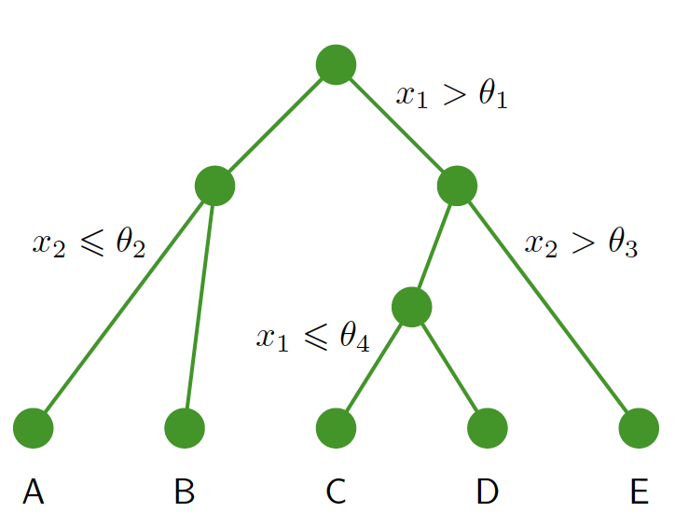
Types of classification algorithms
Tree based Models - Overview
These models separate input space into multiple partitions based on certain conditions and apply different modelling techniques independently on each sub space (ex: binary tree)
For a tree with regions R and T number of leaf nodes, optimal prediction is
Pruning is used for building optimal tree

Slide 9
Thank You!
In our next session:
Classification algorithms covered in this course

